Slide 1

Introduction to GI & DT
Geographic Information Science
SADL – Evert Van Bever
KU Leuven

Slide 2
Table of content
What is GIS?
Definition and properties
Spatial reference system
Geoprocessing
Digital Twins

Slide 3
Learning objectives
At the end of the course the participants should be able to:
explain what GIS is.
describe different datatypes
give examples of layer
explain what a digital twin is
describe use cases of digital twin use
Describe users and needs for digital twins

Slide 4
What is GI?
1

Slide 5
GI
Is an abbreviation of:
G – Geographic
I – Information
Often spoken about
GIS: Geospatial Information Systems, Geospatial Information Science
GIT: Geospatial information Technology
From here on we will use GIS
Notes:
Abbreviation with multiple meanings.

Slide 6


Geographic Information System
Definitions
USGS (United States Geological Survey):
“is a computer system capable of capturing, storing, analyzing, and displaying geographically referenced information; that is, data identified according to location. Practitioners also define a GIS as including the procedures, operating personnel, and spatial data that go into the system."
ESRI:
"is a computer-based tool for mapping and analyzing things that exist and events that happen on earth. GIS technology integrates common database operations such as query and statistical analysis with the unique visualization and geographic analysis benefits offered by maps.“
The spatial (geographic) part differentiates a GIS from a standard computer database.
Notes:
Different definitions of GIS, bit multiple elements overlap.

Slide 7





GIS components
A GIS consists of five key components
hardware
software
data
people
methods
Notes:
There are five componants that are part of a GIS.
First there is the hardware, in short the computer you work on. There are some requirements for this, the PC has to be able to run the software.
This directly mentions the second componant, software to do you GIS- work in. In another slide the focus is on this.
The software however does not make analyses, viewings, … from thin air. Data is needed to use in this software. And the use is done by an operator, the human component.
Lastly methods are used.

Slide 8
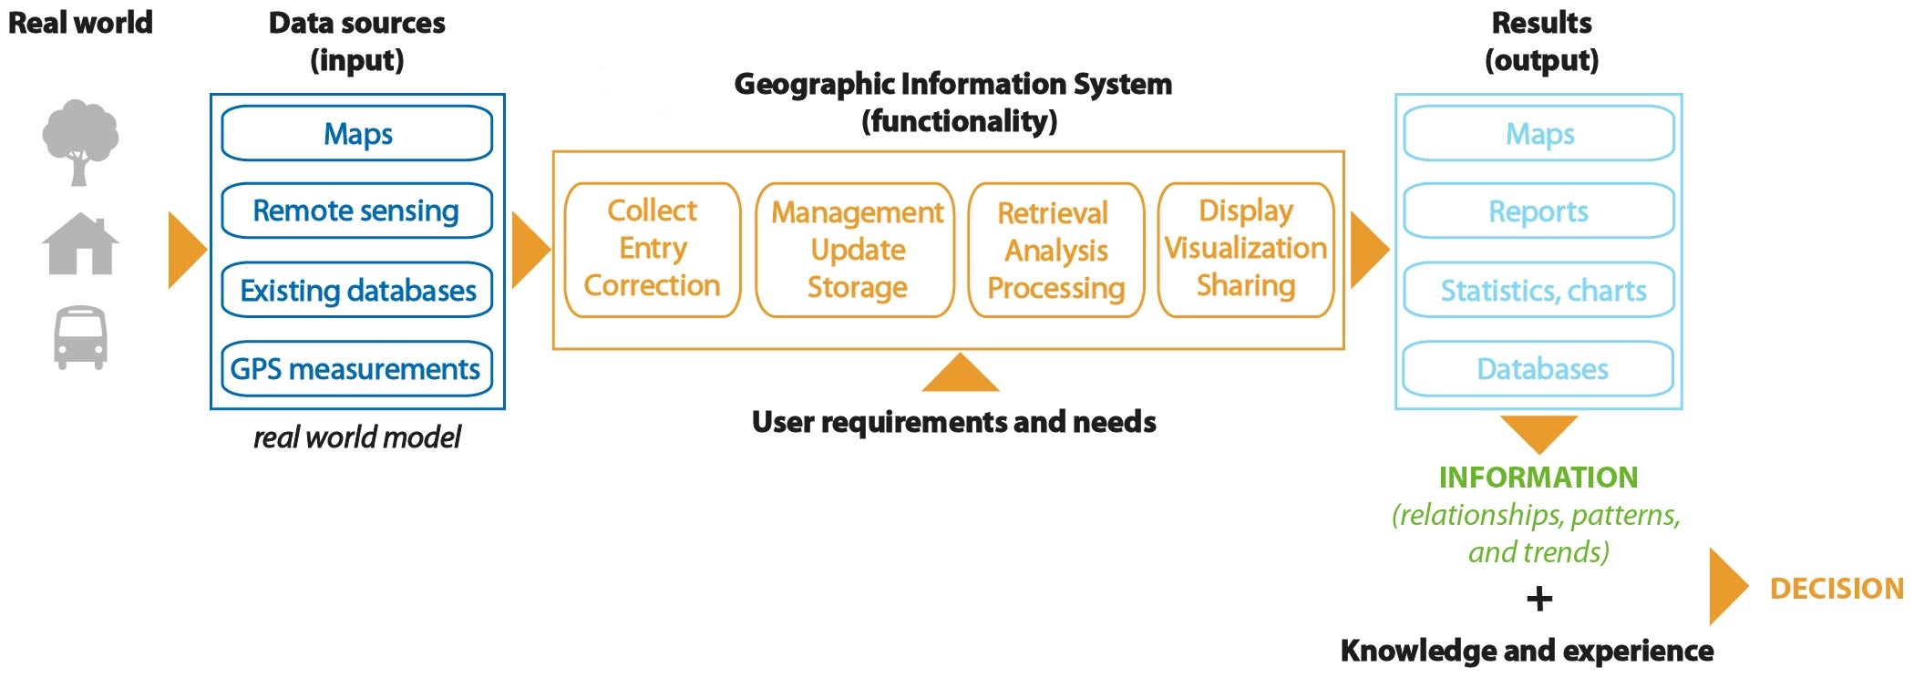
Main idea of GIS
The main goal of GIS is to provide spatial information to decision makers.
Notes:
One of the ideas in GIS is to provide spatial information to decision makers.
This however is not a one step story. There are multiple steps involved in creating this.
First the real world information, the actually reality has to be converted into the input of a GIS. Create the data, model the data. Is done through multiple methods, one of the most relevant once in the context of the course: remote sensing.
From this data the user can modify, the data with multiple processing tools. Mentioned in the orange part.
Out of this results can be generated, a classic result is a map, but statistics or new data is also possible.
This in itself can then serve as information for people to connect with their knowledge and often experience to use for decisions.

Slide 9








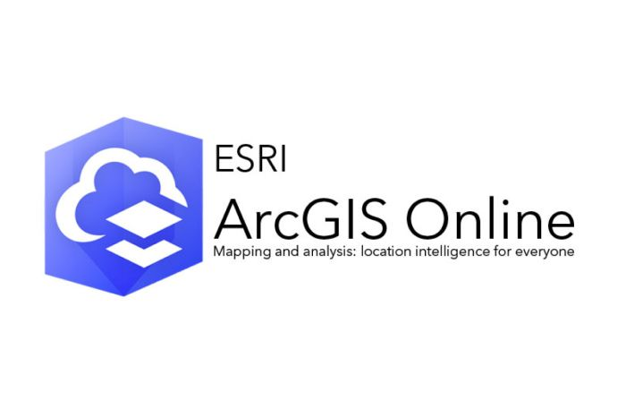






Software
Geospatial software and tools:
Desktop GIS
GIS as a service
Spatial database management systems
Map servers
Notes:
There are multiple software's available. They can be divided in multiple categories.
Desktop GIS, GIS as a service, Spatial databases (management software) and map servers.
There are multiple examples on here. A couple of known once for the GIS as a service is Google or Apple Maps.
In this course the focus will be on Desktop GIS.

Slide 10
Fields use of GIS
Urban planning
Environment protection and management
Land use monitoring
Agriculture
Transportation/logistics
Emergency management
Network infrastructure management
Tourism
...
Notes:
GIS is used in multiple field, here mentioned are just some examples.

Slide 11
Advantages
Ability to view, visualize and interpret data in the form of maps, charts and reports - relationhips and trends easy to see and understand
Improved decision making and problems solving through specific and detailed information regarding locations of features and phenomena
Reduce costs and increase efficiency
Improved communication between organisations or departments
Notes:
GIS is used in these field for multiple reasons, there are some advantages to using it.
One of the main once being the benefit of viewing the data in a spatial manner. It adds ways to see relationships in a spatial way.
Next to it data can also be shown in charts and reports from GIS.
It also helps to reduce costs and efficiency things.

Slide 12
Definition and properties
2
Notes:
In this second section the focus lies on definitions of elements needed to understand GIS.

Slide 13
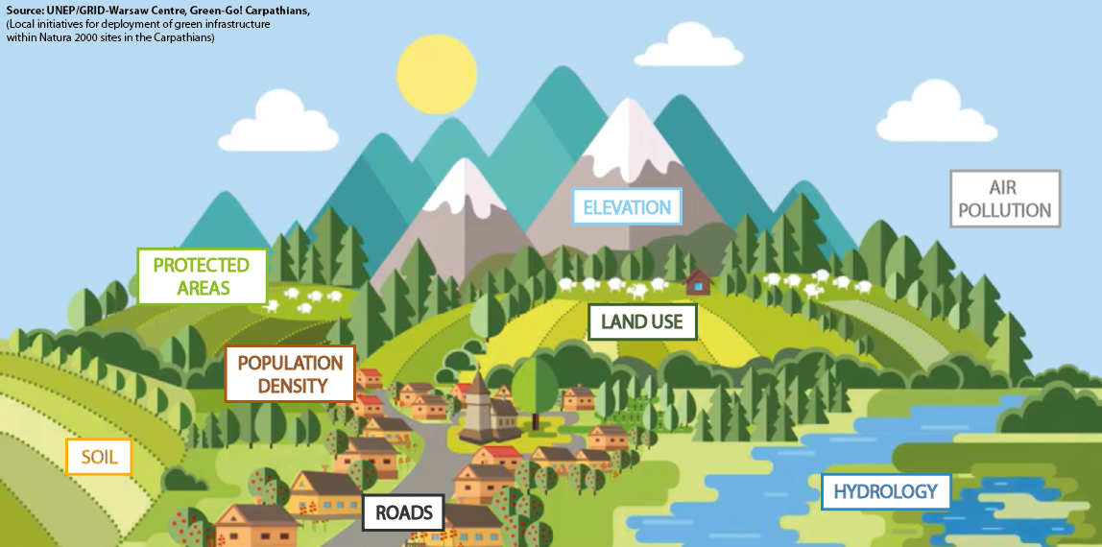

Real world to GIS
Notes:
To transform the real world into a GIS it is extracted in different elements.
In GIS often referred to as layers. They are thematic elements and often research areas.

Slide 14
Spatial data
Definition
Spatial object means an abstract representation of a real-world phenomenon related to a specific location or geographical area.
Spatial data means any data with a direct or indirect reference to a specific location or geographical area.
Spatial data set means an identifiable collection of spatial data.
DIRECTIVE 2007/2/EC of the European Parliament ad of the Council of 14 March 2007 establishing an Infrastructure for Spatial Information in the European Community (INSPIRE)
Notes:
When talking about spatial data it is important to know what it actually is.
There are three ‘spatial’ terms that need to be distinct.
First up, a spatial object is an abstract representation of a real-world phenomena in that specific location. E.g. a house
Spatial data on the other hand relates to all data that has a reference to a location, geographical area.
As a logical consequence, a spatial data set is a collection of spatial data.

Slide 15
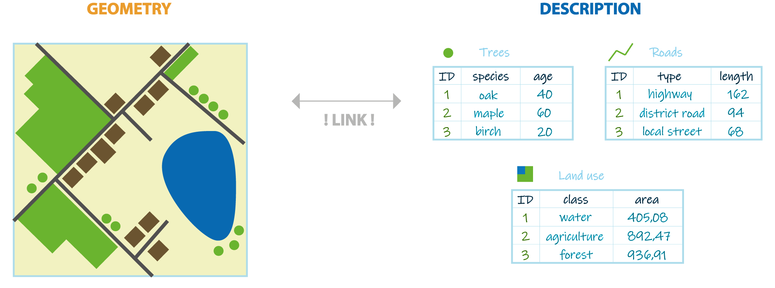
Spatial data
Properties
Spatial data describes shape, location, spatial relationships and attributes of features related to the Earth's surface.
Notes:
Spatial data has 2 properties.
The geometry existing out of shape, location and spatial relation simply station what one can see
and the attributes, or other descriptive information of that certain geometry.

Slide 16
Data model
Data model is a set of guidelines to convert the real world (called entity) to the digitally and logically represented spatial objects consisting of the attributes and geometry.
The attributes are managed by thematic or semantic structure while the geometry is represented by geometric-topological structure.
Shunji, 1999
Notes:
How the real world is converted into a digital version depends on the way it is done. How it is represented.
We call this the data model.
Attributes are combined on thematic or semantic structures.
Next to this there is also the exact representation or the geometric-topological structure.

Slide 17


Spatial data representation model
2 common spatial data models
Vector
Raster
Notes:
There are 2 common spatial models to represent information
Vectors: points, lines, polygons
Raster: with cells, equivalents to the vectors are then single cel, row of cells and group of cells

Slide 18
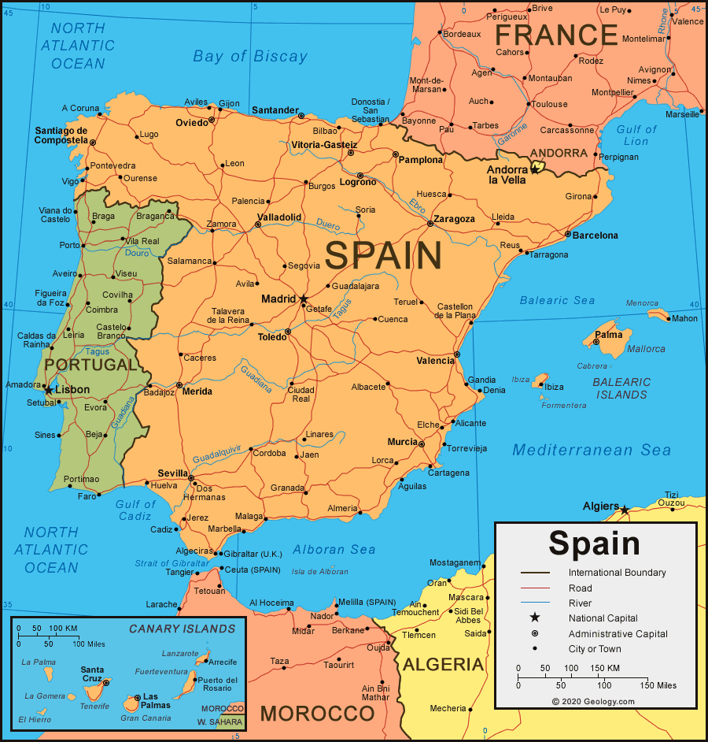
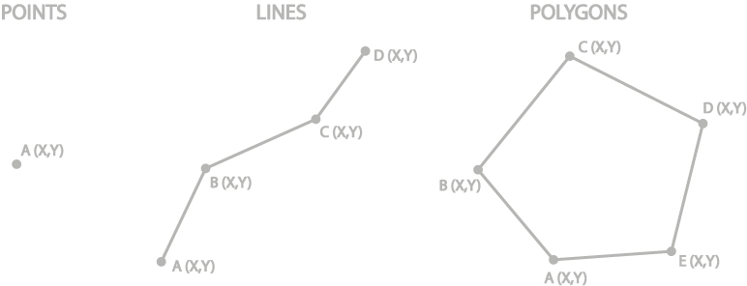
Vector
Geometry types
A vector data model defines discrete objects such as fire hydrants, rivers, lakes.
A vector data models divided into three basic types:
All three of these types of vector data are composed of coordinates and attributes attached to the geometry.
Notes:
Spain Map and Satellite Image
Vector data is mostly used for discrete objects. Objects that have defined boundaries.
The model has 3 versions: points, lines and polygons.
Lines exist of characteristic points connected with lines. And in case of a polygon the line is closed.
Some examples: polygon > France, points > cities, lines > not on here but could be rivers

Slide 19
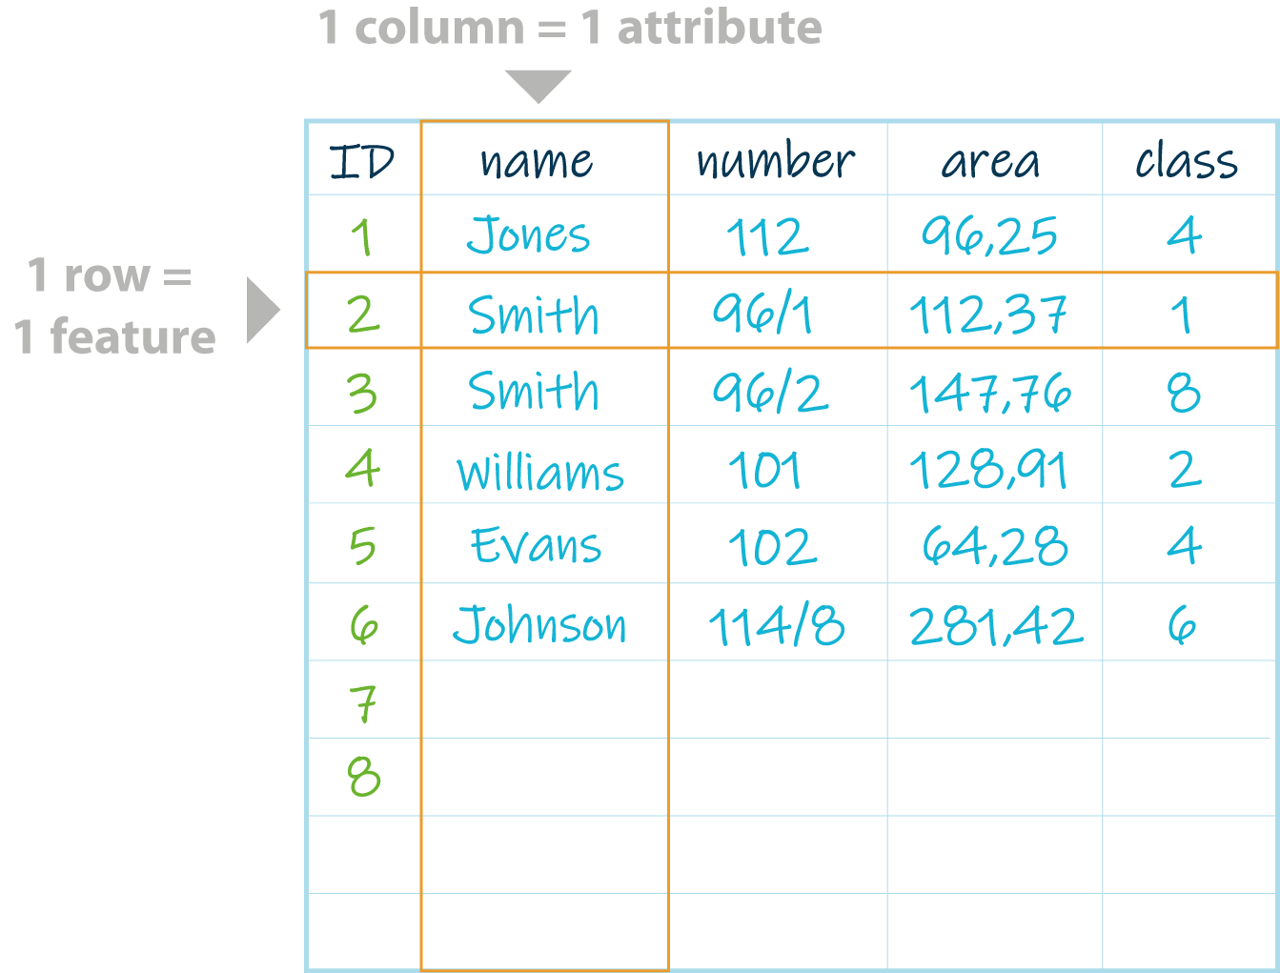
Vector
Attribute table
a nonspatial information about a geographic feature in a GIS
usually stored in a table
linked to the feature by a unique identifier (ID)
A database or tabular file containing information about a set of geographic features, usually arranged so that:
each row represents a feature
each column represents one feature attribute.
The attribute values can be used to find, query, analyze and symbolize features.
Notes:
Vector data always has a attribute table attached to it.
It provides information of the non-geographical order.
Each spatial entity has a row in this table linked with a unique identifier. Columns represent the information on something.

Slide 20
Raster
Model
A raster data model defines continous data and phenomena.
Raster's are:
digital aerial photographs and satellites imagery (spectral data),
continuous data represents phenomena - e.g. temperature, precipitation, elevation, slope,
digital pictures, scanned maps and plans.
Example: height
Notes:
Raster are used more often for continuous phenomena, not with strictly defined boundaries. Examples are temperature, elevation, .
Other data that is displayed as raster is picture (areal, satellite, …) as they have pixels = cell
Hoogtemetingen in Frankrijk zijn gebaseerd op het gemiddeld zeeniveau in Marseille dat 1,82 meter hoger ligt dan TAW.

Slide 21
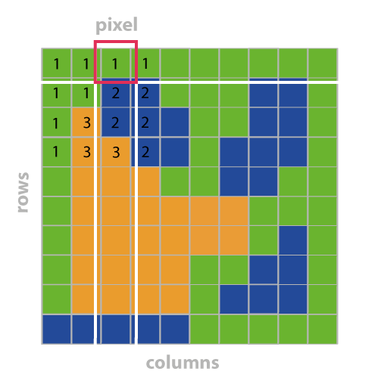
Raster
Geometry
A raster consists of:
a matrix of cells (or pixels)
organized into rows and columns (or a grid)
where each cell contains one value representing information such as temperature, elevation, or spectral data.
Pixel - smallest visible element of an image.
Grid - 2-D object feature that represents a single element of a continous surface.
Notes:
A raster consists of pixels in a matrix. With rows and columns
For each cell there is (in the classic case) one value or information on the spectral data.

Slide 22
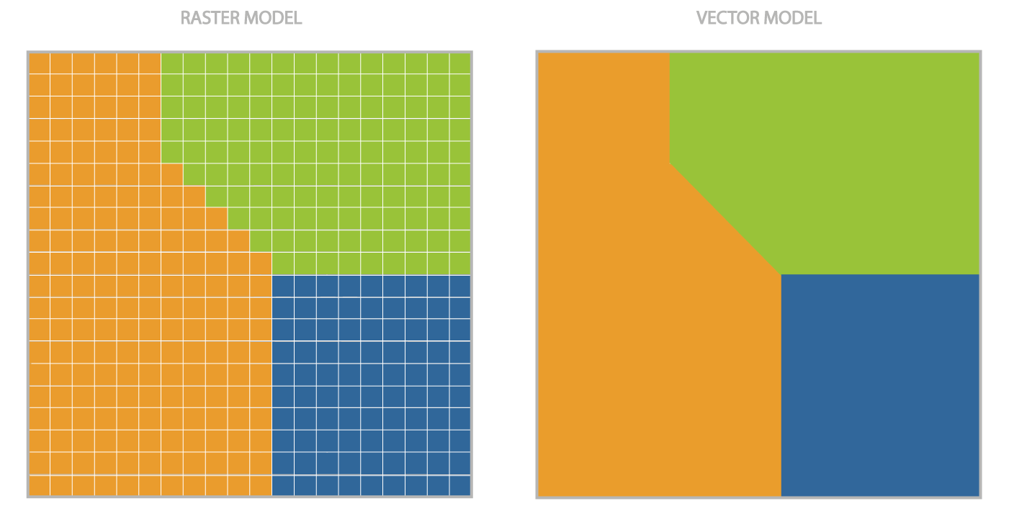
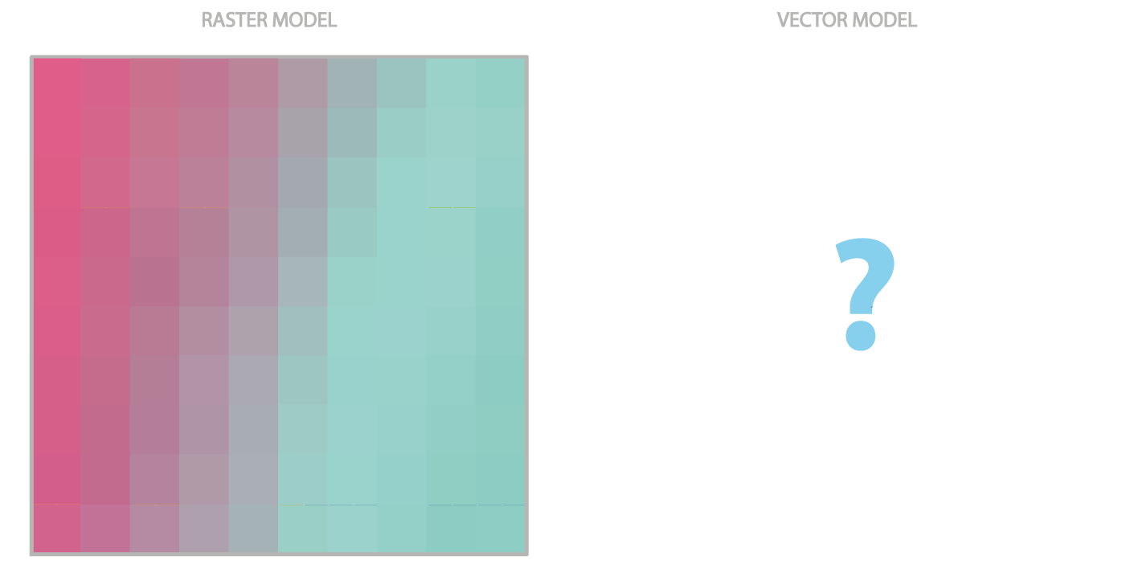
Raster vs Vector
Notes:
Where most vectors can be represented in a vector model, it is often harder the other way around.
In the case of vector to raster one can see some detail is lost.
In the case of raster to vector it can be impossible to represent the continuous changing data as vector.

Slide 23
File formats
Vector | Raster
ESRI Shapefile - the most common geospatial file type developed by ESRI, consists of: shp (feature geometry) shx (shape index position) dbf (attribute data) prj (projection system metadata) xml (associated metadata) GML (Geography Markup Language) - XML based open standard for GIS data exchange KML/KMZ (Google Keyhole Markup Language) - XML based open standard for GIS data exchange GPX (GPS eXchange Format) - GPS data file GeoJSON (Geographic JavaScript Object Notation) - a lightweight format based on JSON, used by many open source GIS packages | GeoTIFF - TIFF variant enriched with GIS relevant metadata, may be accompanied by other files: tfw (raster geolocation) xml (metadata) aux (projections and other information) ovr (pyramid files improves performance for raster display) IMG - ERDAS IMAGINE image file format ESRI Grid - format developed by Esri, which has two varieties: binary or ASCII

Slide 24
Spatial reference system
4
Notes:
One important part of GIS is the used spatial reference system. That adds the earlier mentioned absolute reference system.

Slide 25
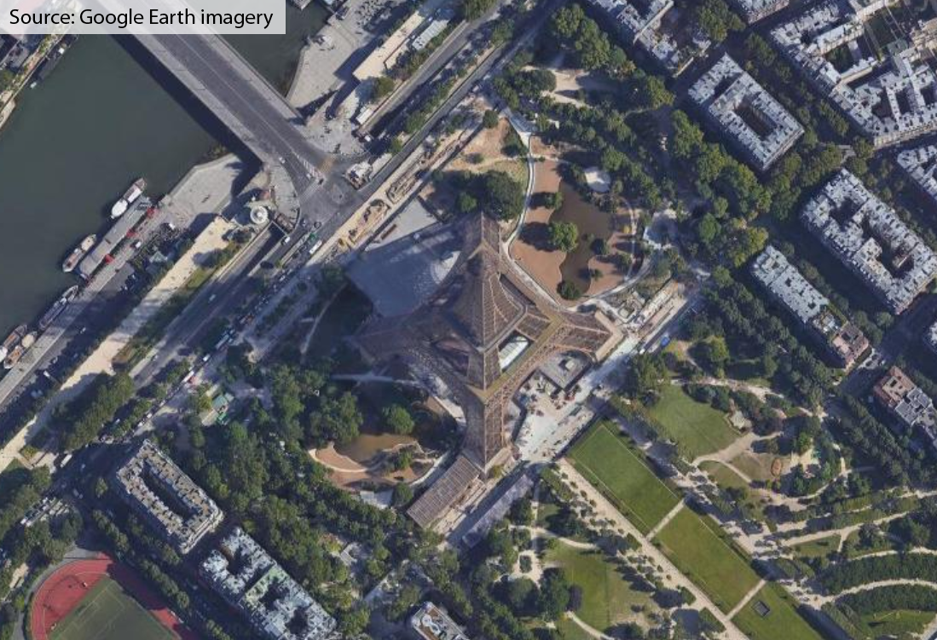
Spatial reference system
Definition
A spatial reference describes where features are located in the real world.
It is a key component of spatial data and applications and differentiates a GIS from a standard databases.
A spatial reference system (SRS) or coordinate reference system (CRS) is a coordinate-based local, regional or global system used to locate geographical entities.
Champ de Mars, 5 Avenue Anatole France, 75007 Paris, France
48° 51' 29.1348''N; 2° 17' 40.8984‘’ E (= 48.858093; 2.294694)
448256.00 m E; 5411928.00 m N
Notes:
A spatial reference system is thus used to describe where a feature is located in the real world. And as mentioned the main element, adding spatial data, of a GIS.
Another word for SRS is a coordinate reference system or CRS, often mentioned when doing GIS.
There are multiple types, like a coordinate-based one. This can be local, regional or global.
An example of a non-coordinate-based reference system is an address, like on the slide.
A global one, most people know is X° east or west & Y° north or south.
A local one is (often) created by the country. Regional is one for example of Europe.

Slide 26
Projected coordinate system
EPSG code
EPSG codes are 4-5 digit numbers that represent coordinate reference system definitions.
GIS uses these to identify how the data must be projected or transformed
Common EPSG:
EPSG:4258 - ETRS89 (European Terrestrial Reference System 1989), geodetic coordinate system for Europe
EPSG:4326 - WGS 84, latitude/longitude coordinate system based on the Earth's center of mass, used by the Global Positioning System among others
EPSG:3857 - Web Mercator projection used for display by many web-based mapping tools, including Google Maps and OpenStreetMap
Notes:
Because there are so many different projections with names they are simplified and tracked by a code, an EPS-code.
This code is used to select the correct projection system in a GIS.
Some common, and often used ones are mentioned in the slides.
Source: Stal, C., De Sloover, L., Verbeurgt, J., & De Wulf, A. (2022). On finding a projected coordinate reference system. Geographies, 2(2), 245-257. https://doi.org/10.3390/geographies2020017

Slide 27
Geoprocessing
5
Notes:
Until here the focus lied on all elements to ‘build’ a GIS.
Now some explanations will be shown on the analysis one can do in GIS.
The focus here will mainly lie on vector analysis, as rasters will be looked at in another session.

Slide 28
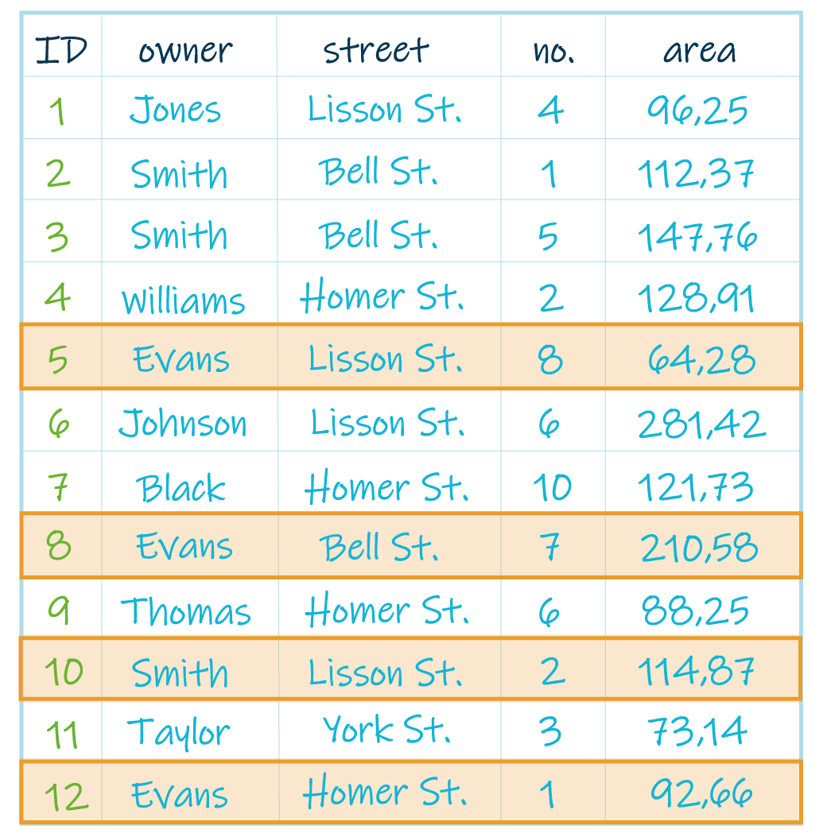
Attribute query
process of searching and retrieving records of features in a database based on desired attribute values.
"owner" = 'Evans' OR ("owner" = 'Smith' AND "street" = 'Lisson St.')
Notes:
The less ‘spatial’ elements of data are as mentioned stored in an attribute table.
One can select elements (point, lines, polygons) based on these information. In IT-langues we speak about querying.
An example is shown here, where we want the parcels selected where the owner is Evans OR Smith. However is the owner is Smith we only want to select the parcels at the street Lisson St

Slide 29
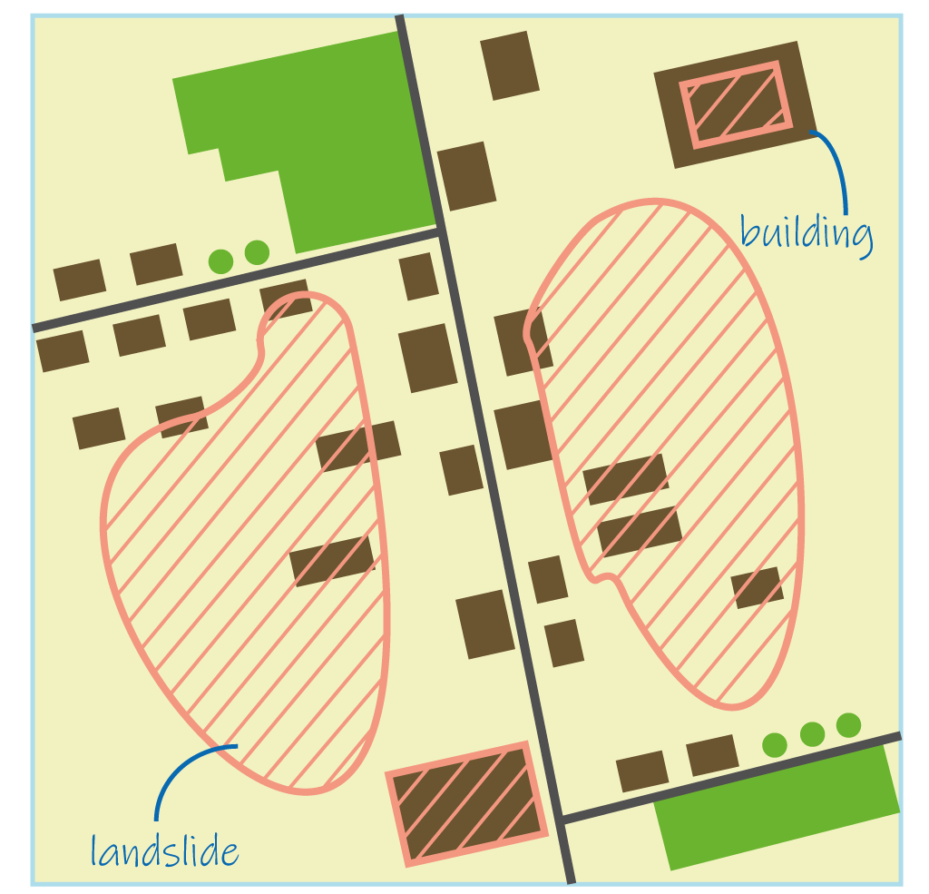
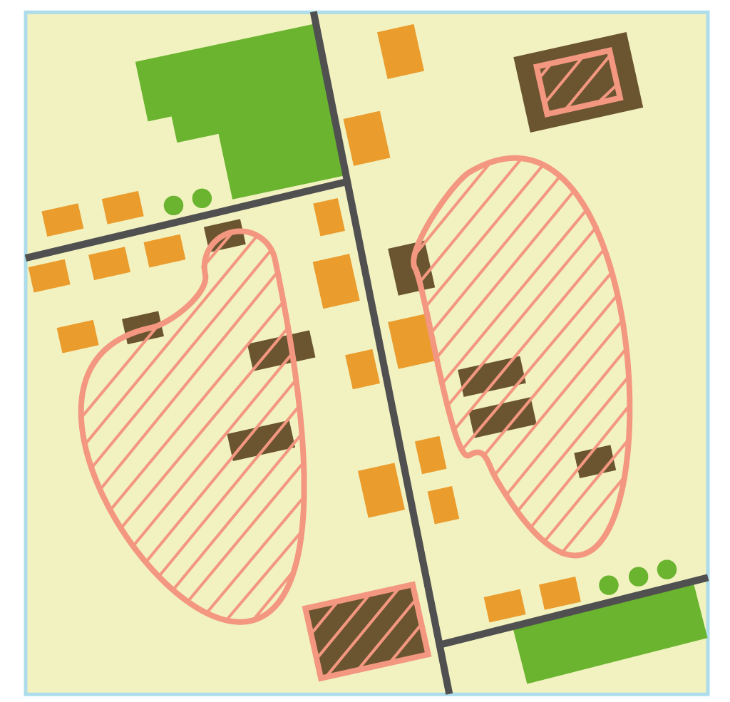
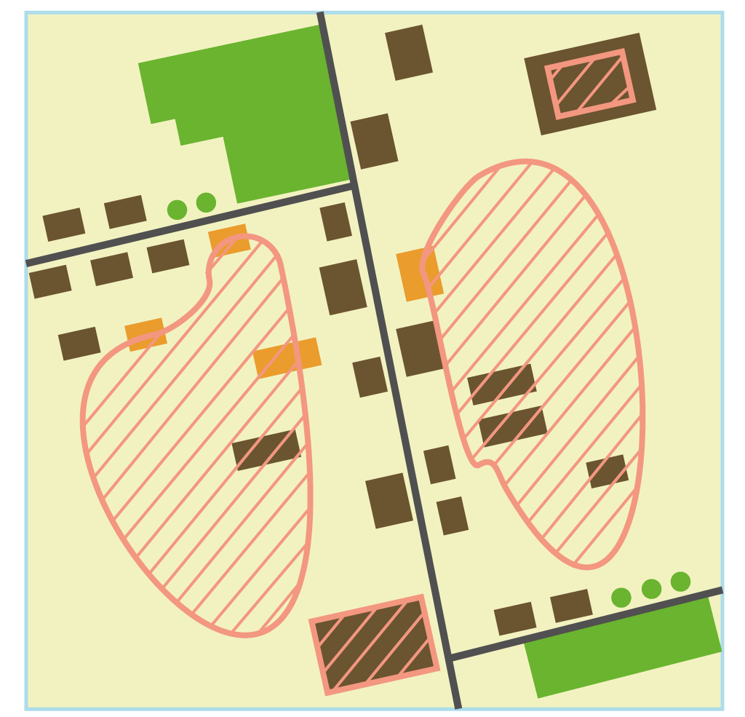
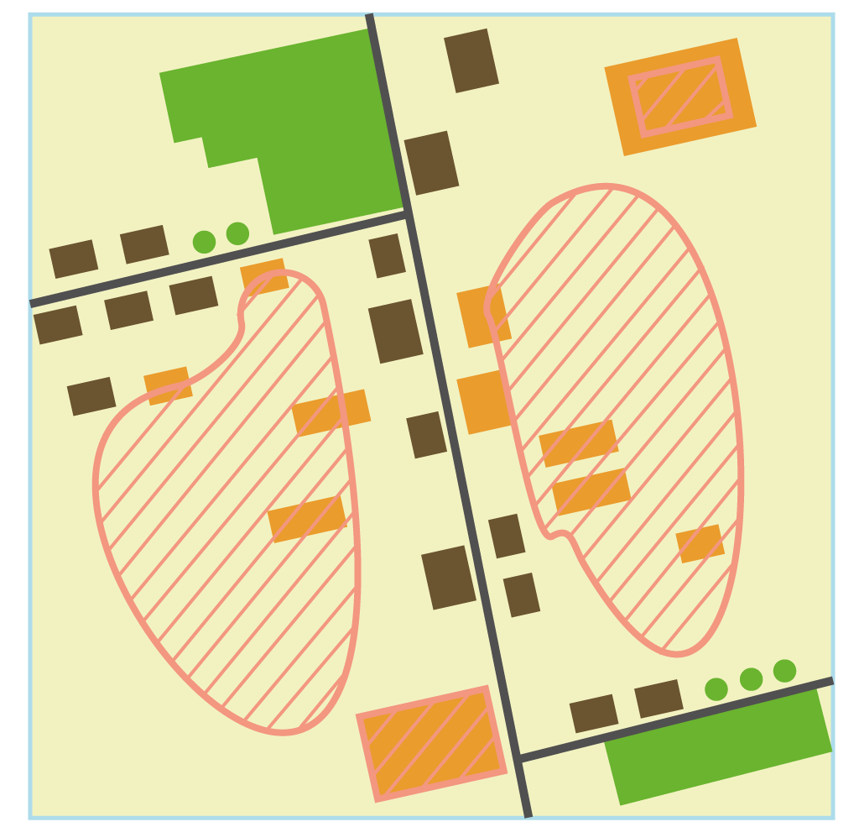
Spatial Query
process of searching and retrieving records of features in a database based on location or spatial relationship.
disjoint
overlaps
intersects
Notes:
Where the previous selections, or queries were based on the attribute table there is also the possibility to query on spatial relationship = what makes GIS unique & useful.
On the top right we see the geo-information.
In the ‘disjoint’ query we want to select the building that have no overlap with no landslides.
For the ‘overlap’ query it is the opposite, we only want buildings that overlap. Note that it is only the overlapping once and not those that fall completely in the landslide.
The last one here, intersect, selects the once that have any intersection or interactions with the areas of landslides.

Slide 30
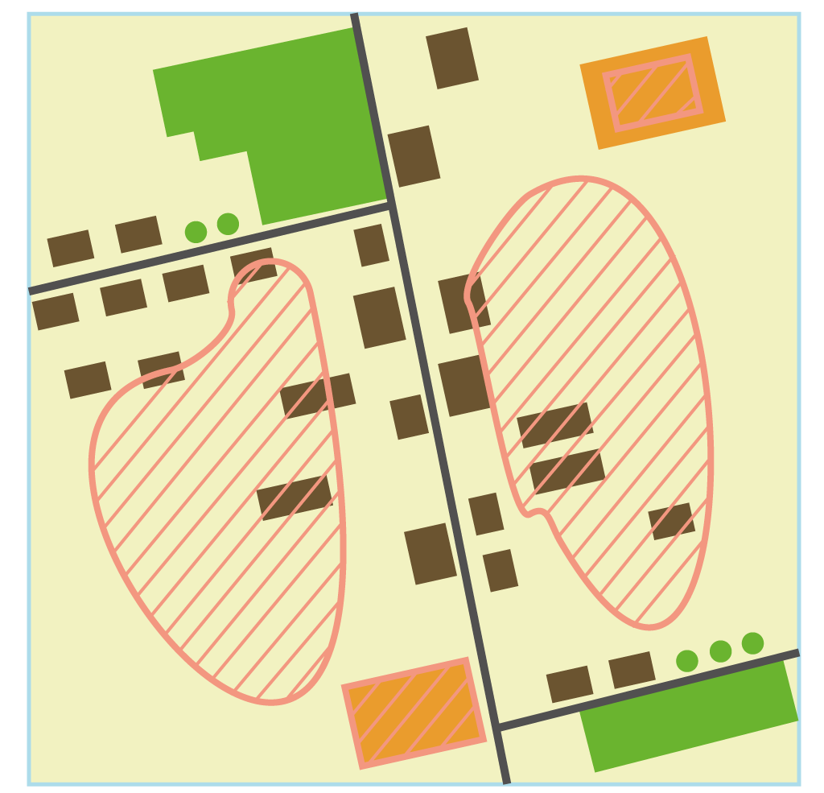
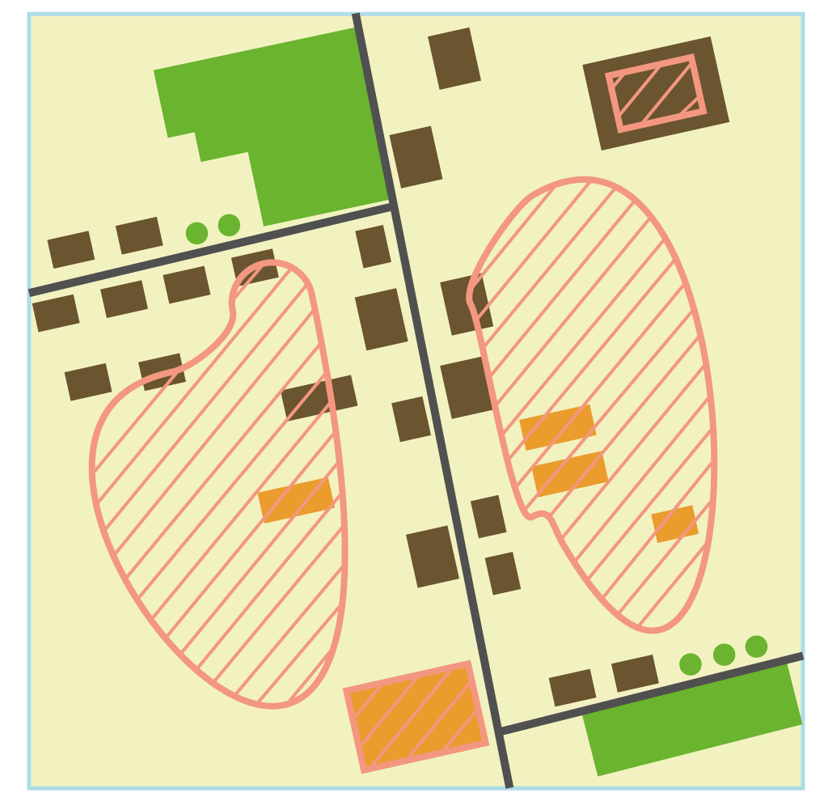
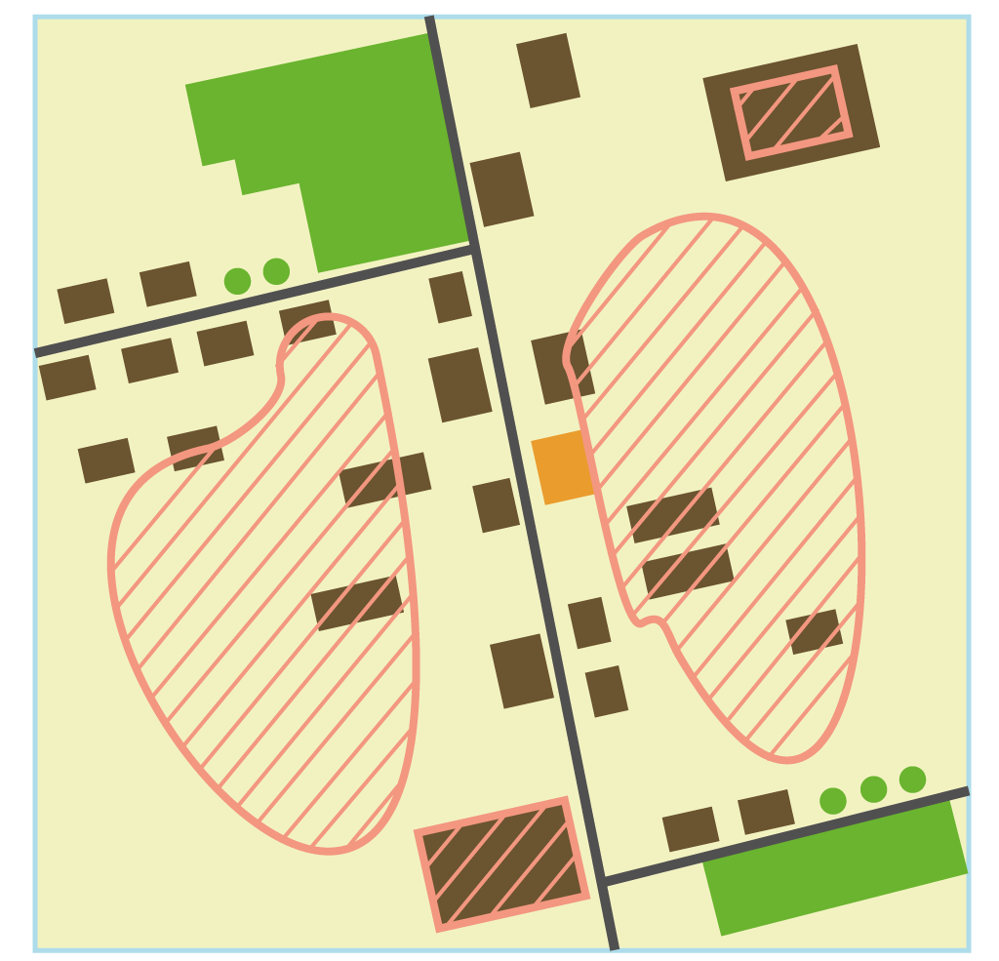
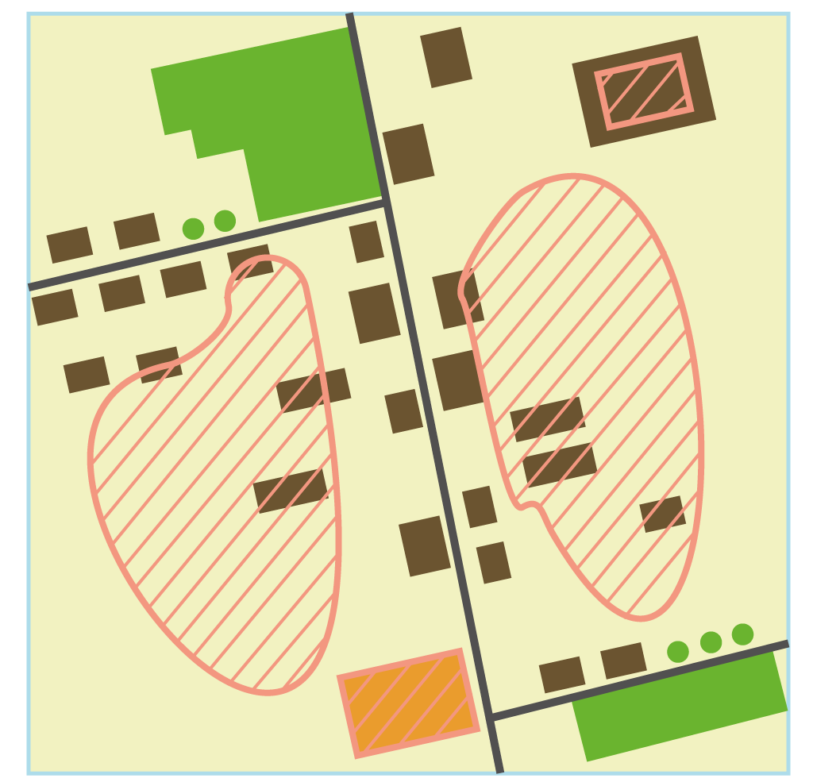
contains
within
touches
equals
Notes:
The query ‘contains’ select only polygon that contain a full shape of the landslide areas.
The query ‘within’ only wants to select houses that are fully in the landslide areas.
For the ‘touches’ query the system only looks at building that touch.
And lastly the ‘equals’ query want a building that stand on the exact same area of the landslide area.

Slide 31
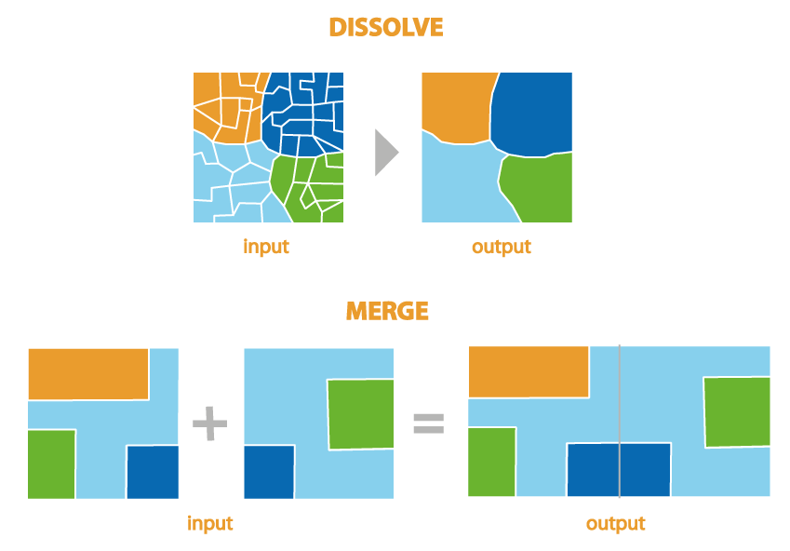
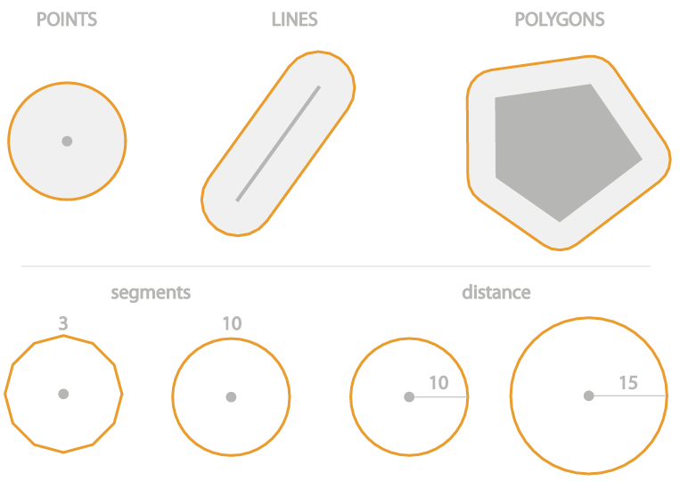
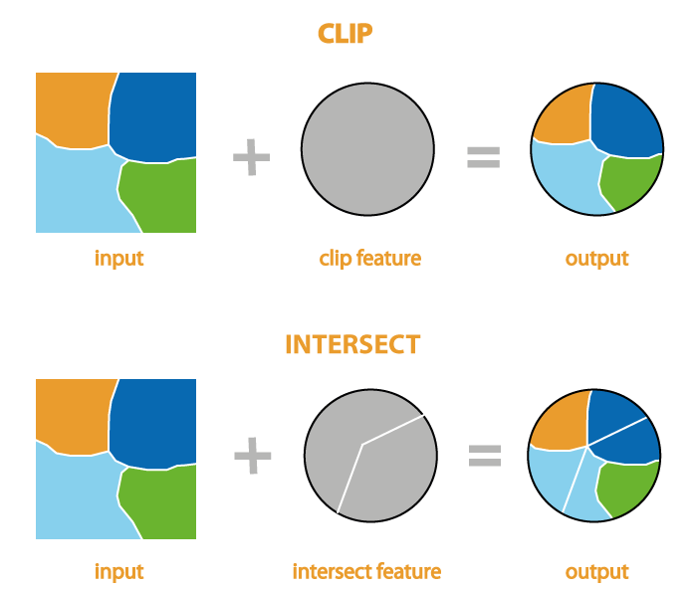
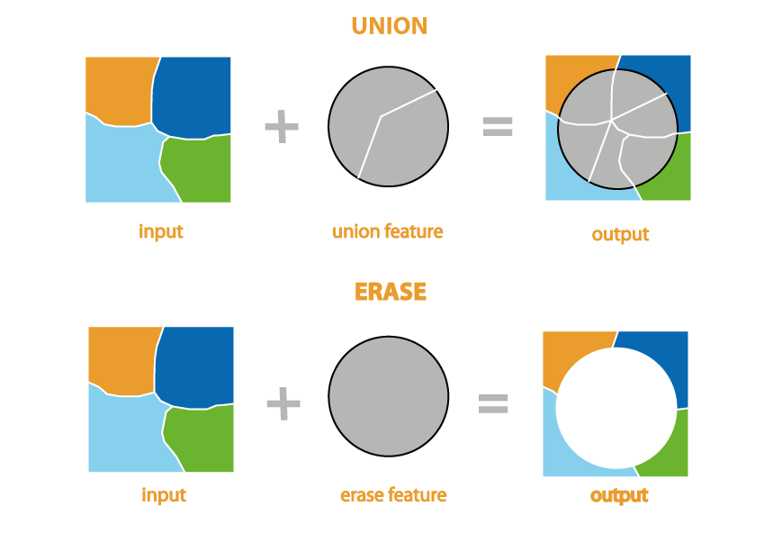
Geoprocessing
Buffer
Notes:
Al precious focused on selecting information. However, the information can also be ‘modified’ with geoprocessing.
On the left the concept of buffering is shown, where on a chosen distance a new polygon is drawn to be able to use that in analysis as ‘in the distance of X to the point-line-polygon’. A buffer is always a polygon regardless of the original type of vector.
On the right different types of data combination is shown. The ‘dissolve’ function will combine polygons with the same values (attributes) into one polygon.
The ‘merge’ function’ will just paste the information together.
On the bottom right more of ‘extraction’ functions are shown.
The clip function is using a certain polygon to only extract what lies within. Often referred to as the cookie cutter.
For the function union the different layer will be combined and taken over from the original information.
Intersect combines both overlapping from both layers, not only the insides from one as with clip.
The last mentioned function ‘erase’ is the opposite as clip and only keeps what is not inside the polygon. A reverse cookie cutting, what is lest from taking out the cookie.

Slide 32
Digital Twins
6

Slide 33
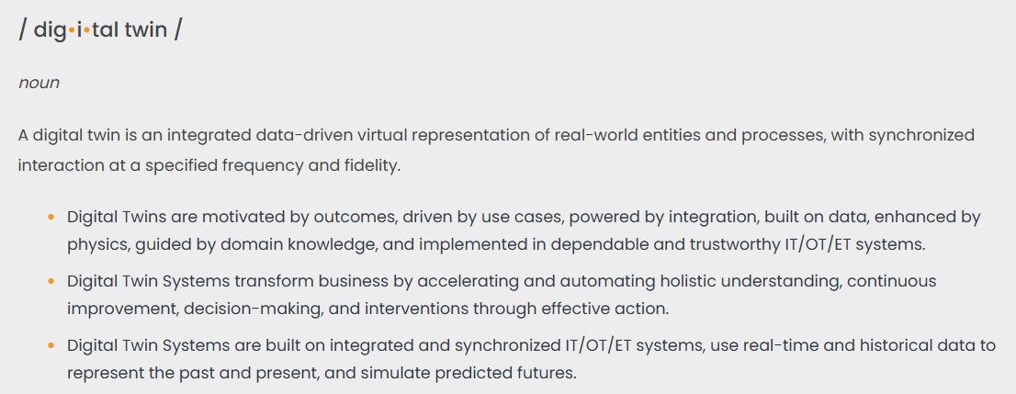

What are Digital Twins?
Source: https://www.digitaltwinconsortium.org/initiatives/the-definition-of-a-digital-twin/
Notes:
It is a way to do integrated data. Make a virtual representation of the real world entitites.
There could/should be a synchronisation between both.
From further on we will talk about urban DT, but know they can be used for non-urban environments.
Urban environments are often more challanging due to their complexity.

Slide 34
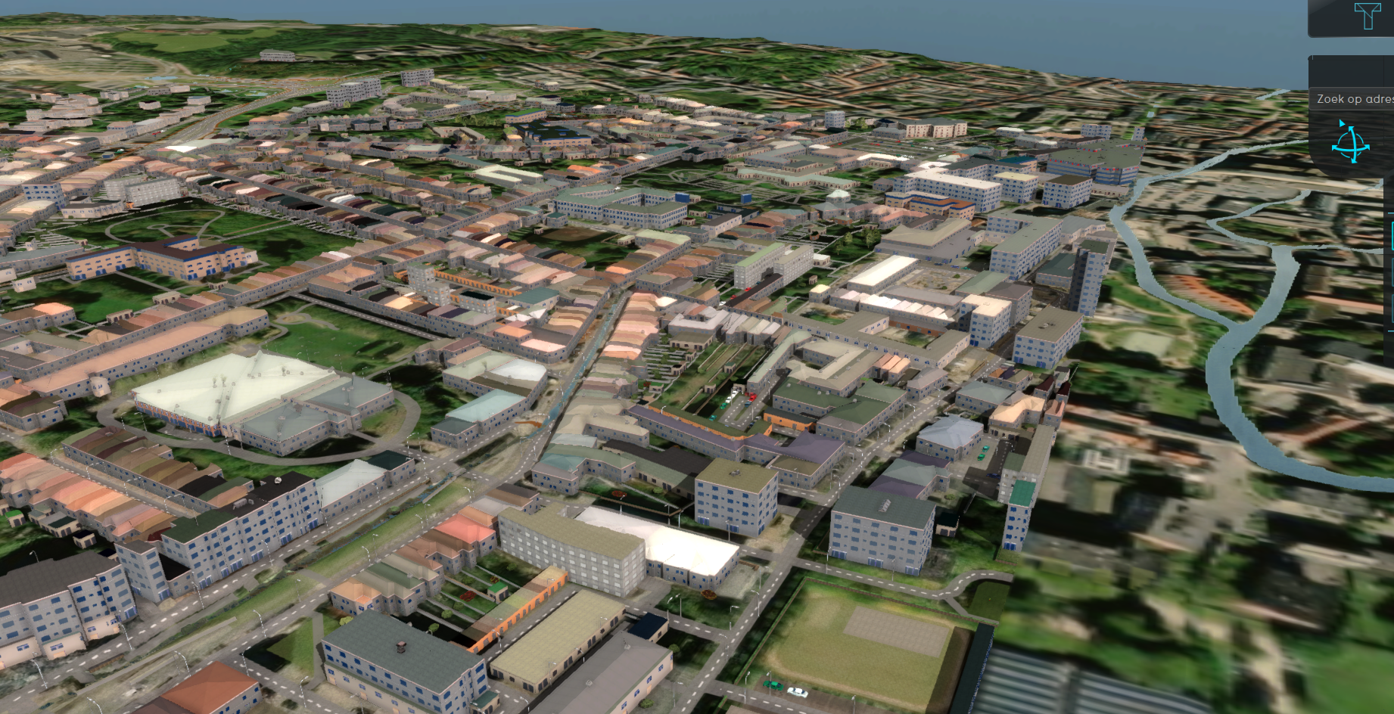

Slide 35
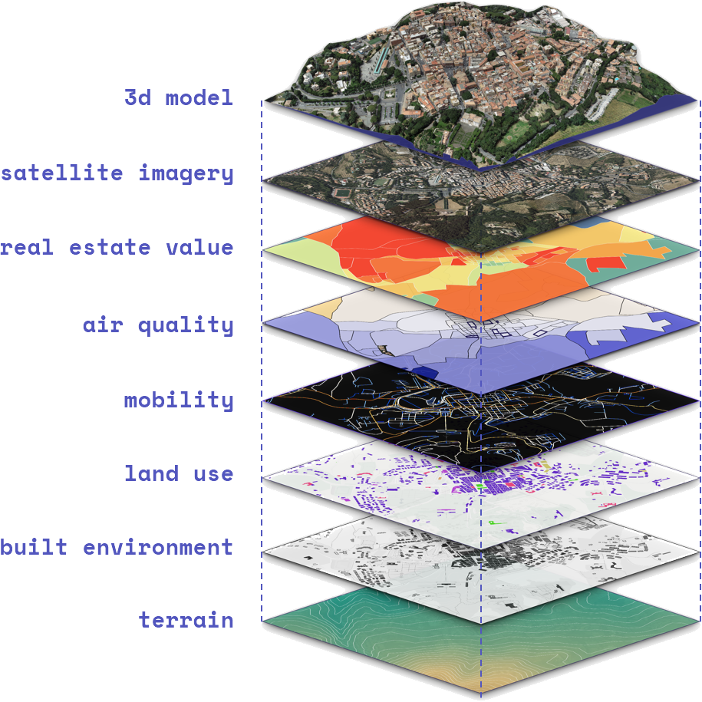
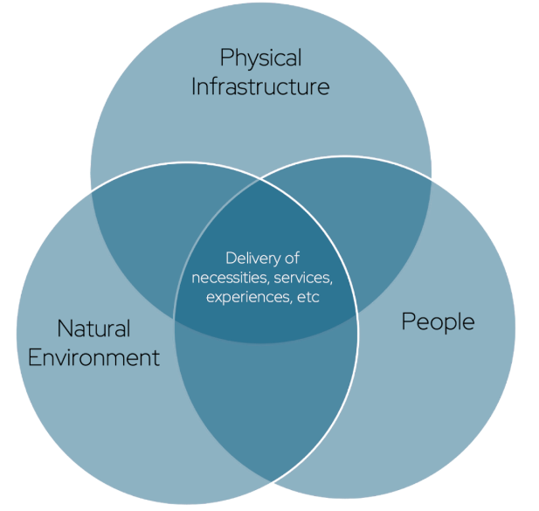
Urban Digital Twins
Urban environments are complex due to:
Infrastructure
= Man-made objects
Roads, buildings, …
Natural environment
Terrain, vegetation, …
Weather, physical processes, …
People
Their behavior, effect on the urban space
Traffic, …
→ Interrelationship between elements
Source: https://docs.ogc.org/dp/24-025.html

Slide 36
Examples
Vancouver airport: www.youtube.com/watch/MJgoOXWz-jQ
Virtual Singapore: www.youtube.com/watch?v=y8cXBSI6o44
DestinE: a digital twin of the earth: https://www.youtube.com/watch?v=FKVHZlGqEyw
DUET – Flanders Ghent: Flanders Twin | digital urban european twins

Slide 37
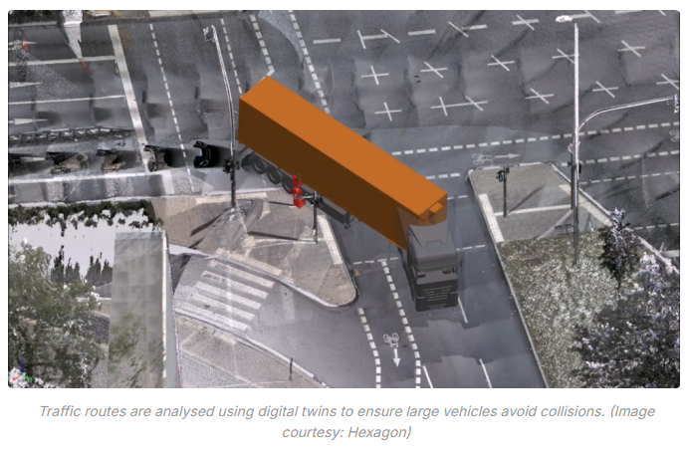
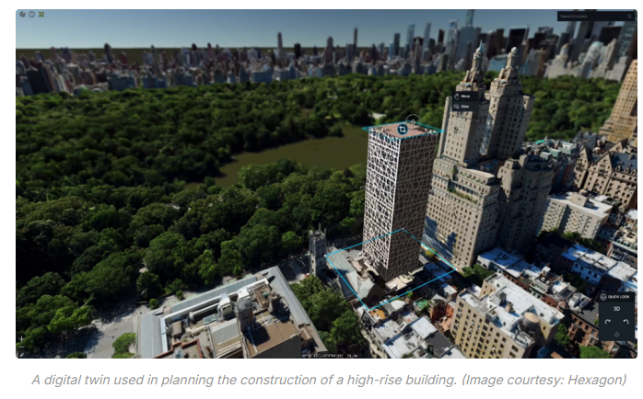
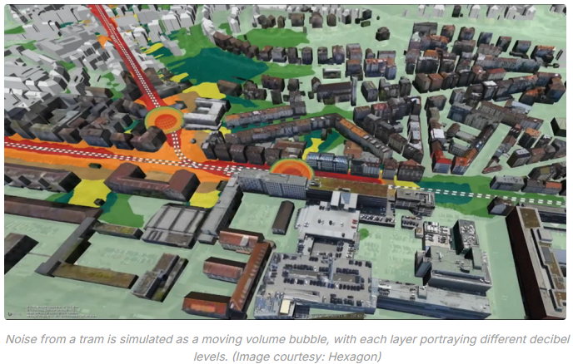
Notes:
Geospatial digital twins will make cities smarter | GIM International

Slide 38
Platforms
Things to consider
Open source vs proprietary software
Self hosting vs Cloud based solutions
Extendibility, customizability
Focus on specific domains
Interoperability (vs platform lock in)
Data sources
…

Slide 39
Platforms
Examples
Esri CityEngine
3DExperience
Tygron platform
DTCC
Bentley ITwin
Augment City
Hexagon M.App Enterprise
Each with it’s Pro’s and Con’s > comparisson in DIS4SME slides

Slide 40
Digital Twin users
Different type of end-users, with each their own needs
5 types of end users
Domain specific public servants
Policy makers
Citizens
→ communication = visualization, made by others
Urban planners
→ work on long term
Emergency responders
→ plan & predict & real time interaction
→ Digital twins are a system that is modular based on the needs of users

Slide 41
Source
This course is based on EO4GEO content:
Grgic, M. (n.d.). Urban heat islands: Basic GIS knowledge, vector and raster data. EO4GEO. Designed and developed by University of Zagreb, Faculty of Geodesy. http://www.eo4geo.eu/training/urban-heat-islands-basic-gis-knowledge-vector-and-raster-data/
The part on Digital Twins is based on the course of DIS4SME

